Slide 1
Will there be a lamb carry-over?

Slide 2
Will there be carryover in lamb in Q1?
October extreme
wet period
No sign of carry-over in lamb

Slide 3
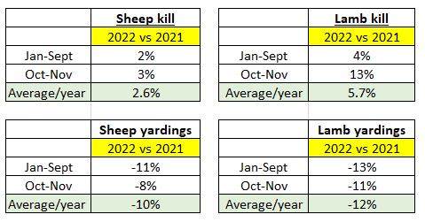

Slide 4
Will lambs fall in Q1 2023
Prices have fallen 3 times in 12 years
Average increase is 9%

